Slide 1
Formula One Dataset
CX4032- Data Analytics and Mining

Slide 2
01
FORMULA ONE DETAILS

Slide 3



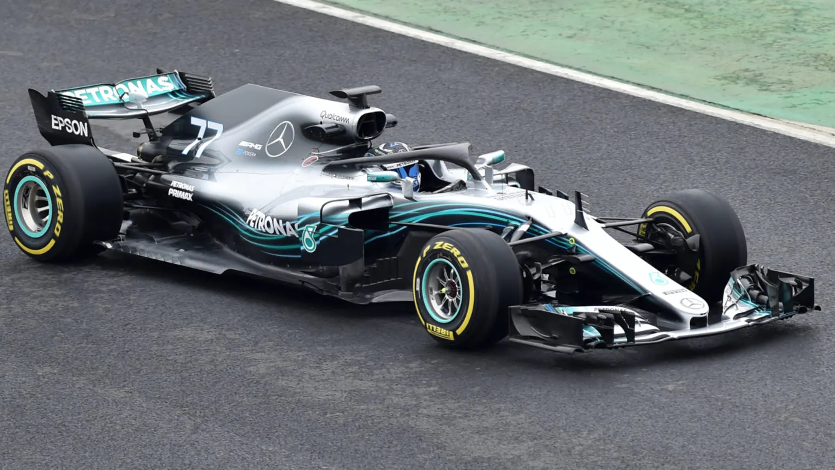
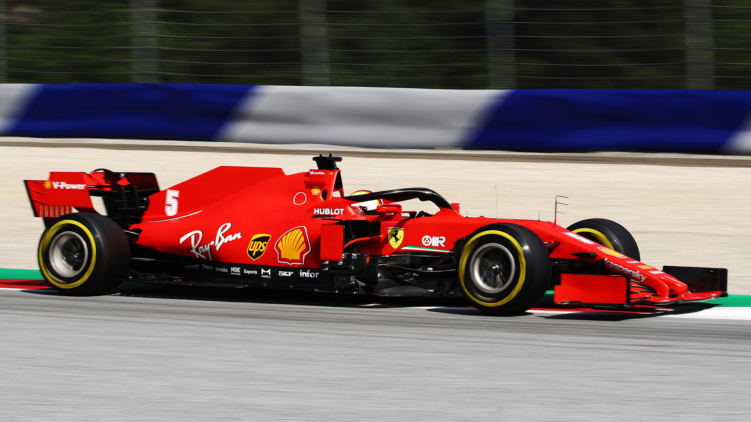
DETAILS
DRIVER
DRIVER CHAMPIONSHIP
CONSTRUCTOR
(TEAM)
.
.
.
DRIVER
CONSTRUCTOR CHAMPIONSHIP
CONSTRUCTOR
(TEAM)

Slide 4
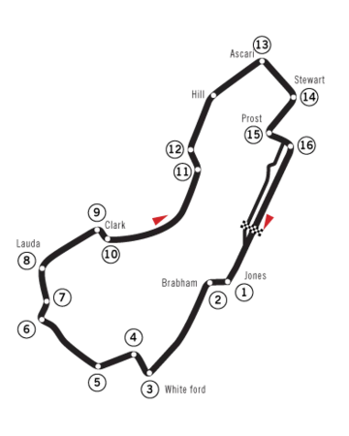
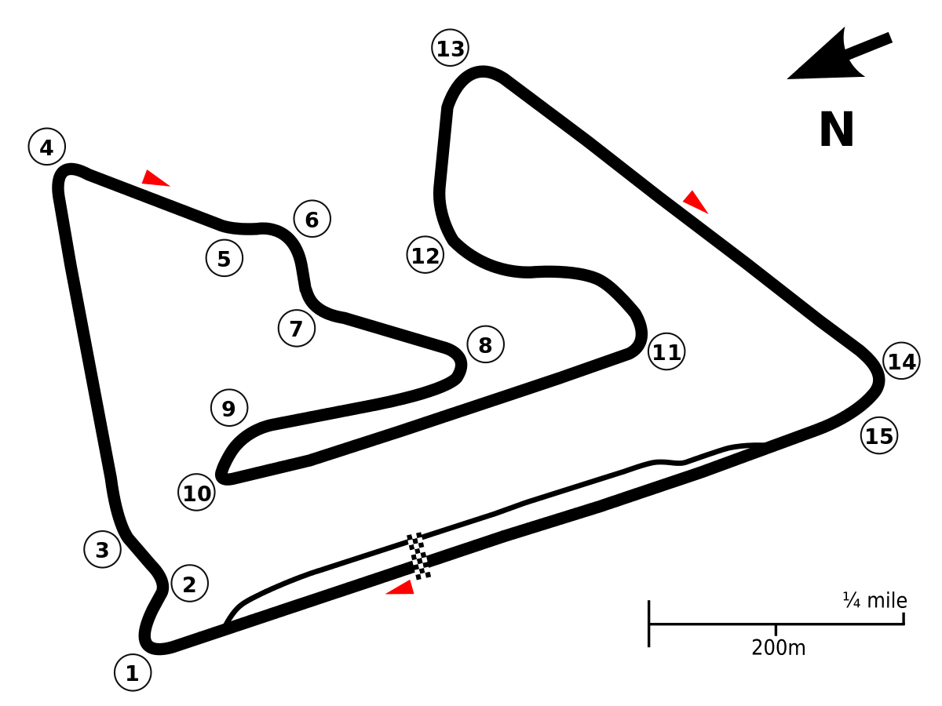
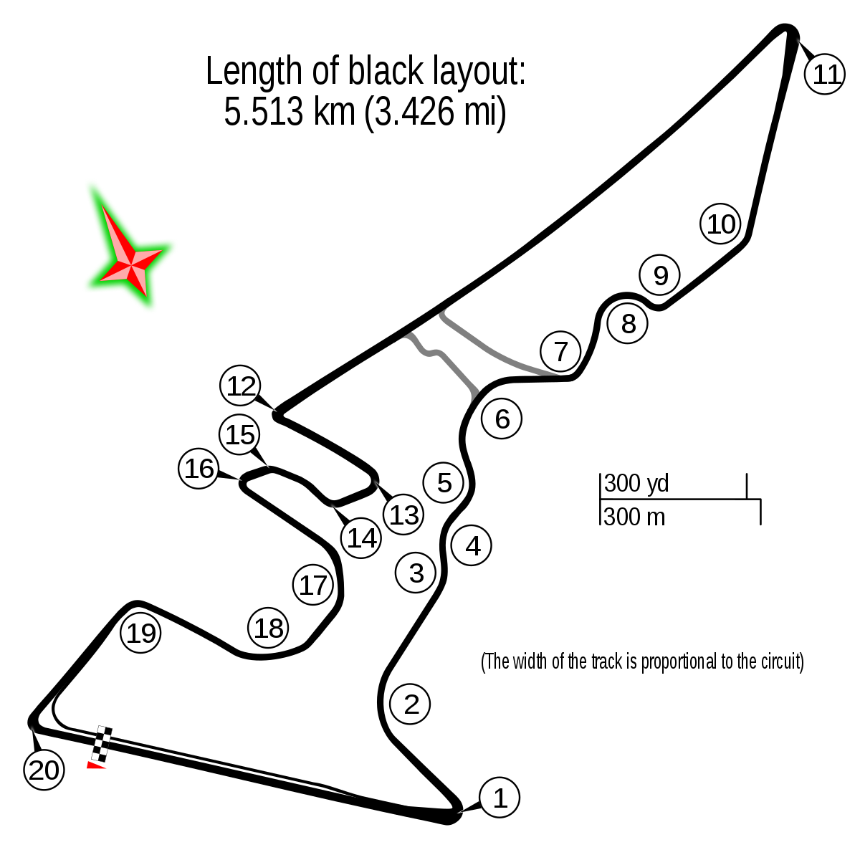
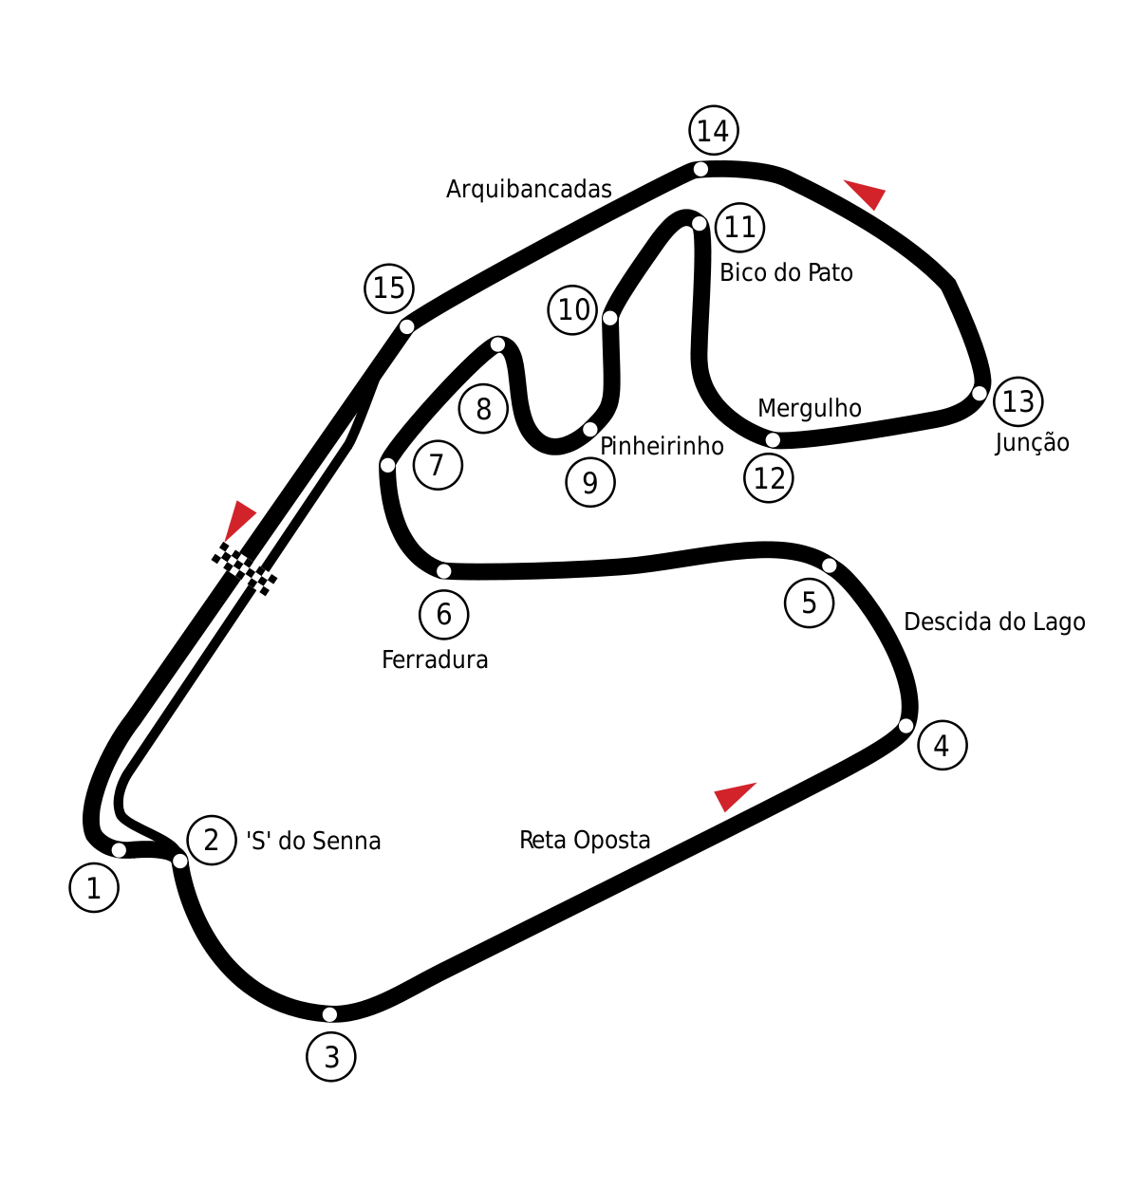
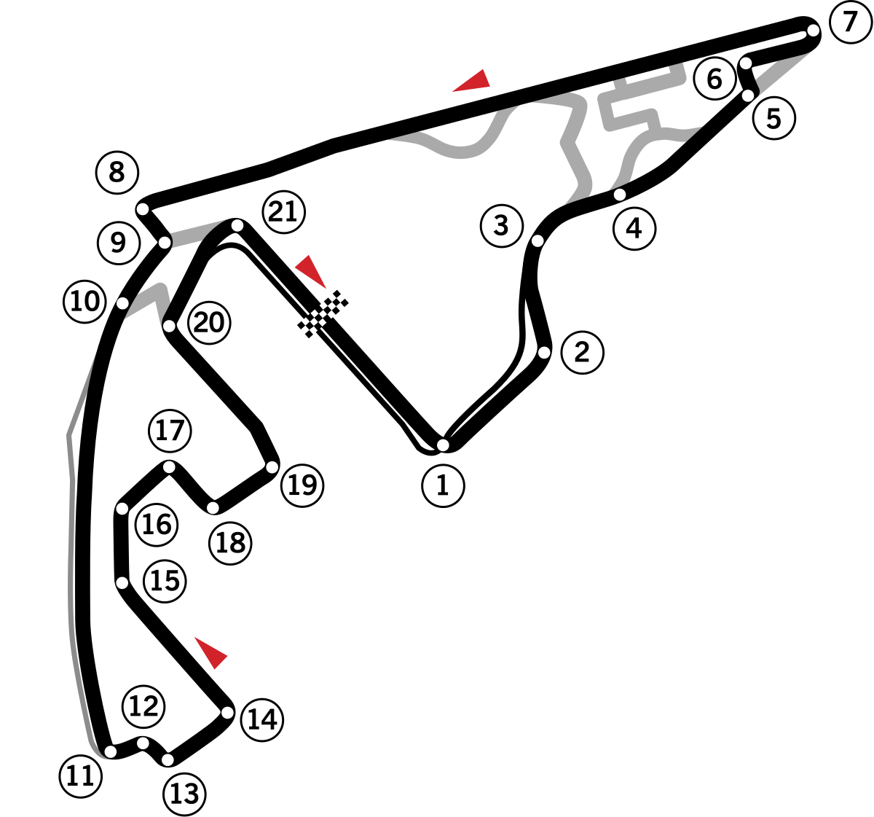
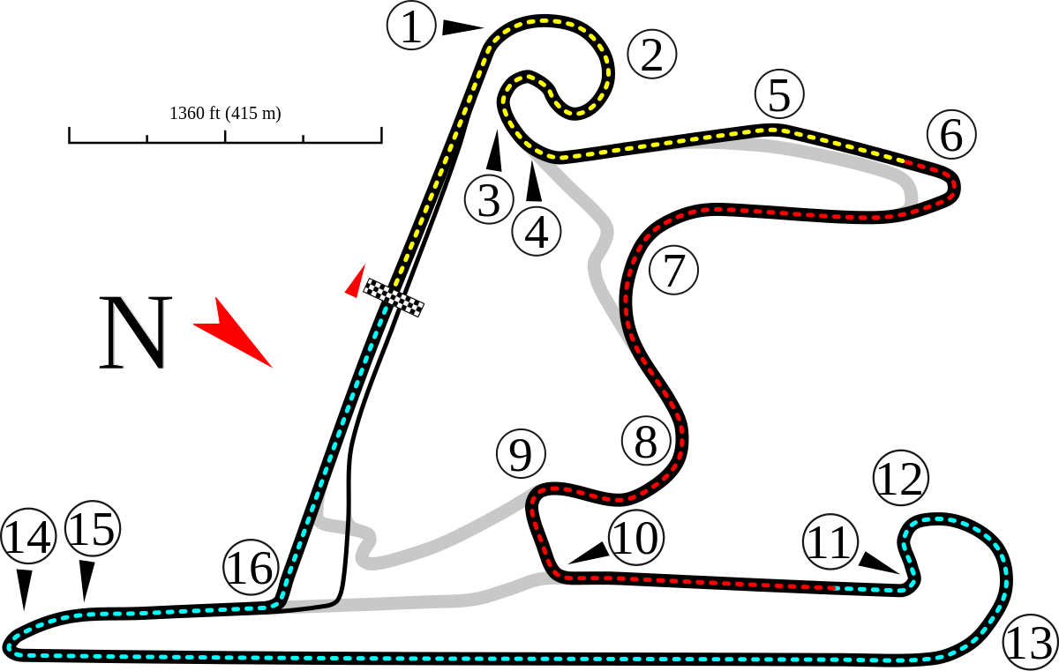
DETAILS
1 F1 Season annually, ~21 Grand Prix (races)
Each race has its own race winners
Points accumulated in each race contributes to the Driver’s Championship and Constructor’s Championship
Australian GP
Bahrain GP
Chinese GP
United States GP
Brazilian GP
Abu Dhabi GP

Slide 5
PROJECT MOTIVATION
KDD:
Improve overall Race Strategy for a Constructor
Increases chance of winning Championships
Winning Constructor Championships will increase Constructor budget for next F1 season

Slide 6
PROJECT GOALS
Driver finishes in Point Winning Position
Fastest Lap Time for a Race
Final Driver Standing for Driver driving a particular Constructor

Slide 7
RESOURCES
F1 Dataset
Jupyter Notebook

Slide 8
02
PROBLEM ONE
Predict if Driver finishes in Point Winning Position (PWP)

Slide 9
PROBLEM 1
PWP
Driver finishes in Top 10
CLASSIFICATION
LABELS
Finish in PWP or not
Finish in PWP: 1
Else: 0

Slide 10
INTEGRATION CLEANING & TRANSFORMING
INTEGRATION:
results_df, status_df, races_df, circuits_df, drivers_df
CLEANING:
Filter rows to year between 2004 to 2017
Remove all rows with NaN value in ‘error-category’
Drop redundant attributes
TRANSFORMATION:
Normalize data by changing values of numeric columns to common scale

Slide 11
3 DIFFERENT INPUTS
Original Dataset with Added Features (B)
Driver Error Rate
Constructor Error Rate
Circuit Error Rate
Original Dataset (A)
Original Dataset with Added Features + Reduce Features (C)

Slide 12
CLASSIFICATION MODEL
SVM
NAIVES BAYES CLASSIFIER
A - 75.6%
B - 76.0%
C - 76.2%
A - 74%
B - 74.4%
C - 74.8%
DECISION TREE CLASSIFIER
RANDOM FOREST CLASSIFIER
A - 68.7%
B - 68.6%
C - 73.5%
A - 72.1%
B - 72.5%
C - 74.4%
Notes:
Using the 3 input datasets, we performed the classification using 4 classifiers namely, the Naives Bayes Classifier, SVM Classifier, Decision tree classifier, and random forest classifier. We then record the test accuracies of the 4 classifiers as shown in the slides above.
As can be seen from the results, we were able to achieve a decent prediction accuracy of between 73-76 percent accuracies for the 4 models.

Slide 13
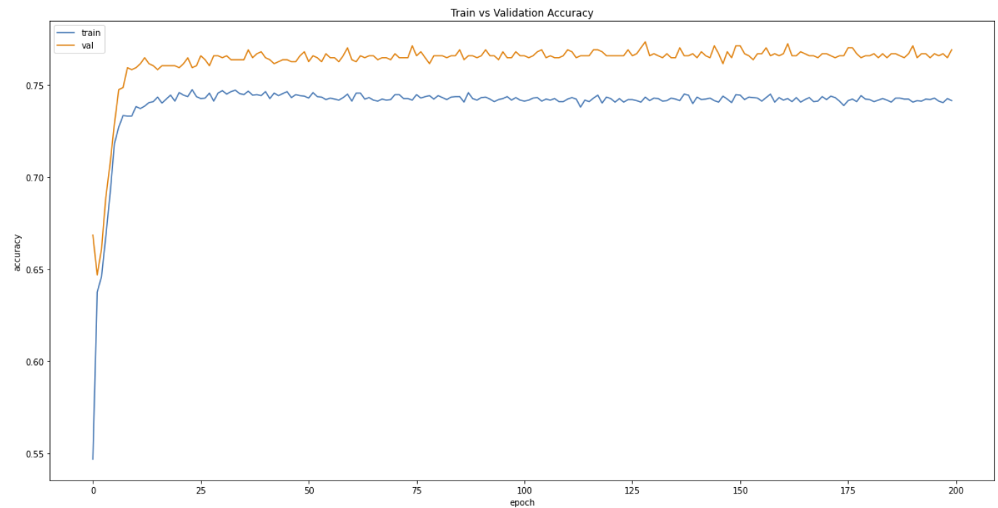
4-LAYERED NEURAL NETWORK
77.36%
(Input C)
Notes:
In addition, in order to see if a neural network is able to better capture the complexities of the input features, we perform the same classification task using
A neural network on the reduced features dataset.
True enough, we were able to improve the test accuracy of the classification to 77.36 percent using a neural network

Slide 14
03
PROBLEM TWO
Predict the Fastest Lap Time for a Race

Slide 15
PROBLEM 2
FASTEST LAP TIME
REGRESSION
Gain additional points
Predict the timing in milliseconds

Slide 16
INTEGRATION CLEANING & TRANSFORMING
INTEGRATION:
qualifying_df, races_df, circuits_df, results_df
CLEANING:
Remove all rows with NaN value in ‘q1’ and ‘fastestLapTime’
Drop redundant attributes
TRANSFORMATION:
Generate new column and insert shortest timing between q1, q2, q3
Normalize data by changing values of numeric columns to common scale

Slide 17
IMPLEMENTATION
4-LAYERED NEURAL NETWORK:
Performs regression
Adam Optimizer
Learning Rate: 0.001
Learning Decay: 1e-6
500 Epochs
75% original dataset
25% used for validation for each epoch
REDUCED DATASET:
sklearn function - SelectKBest

Slide 18
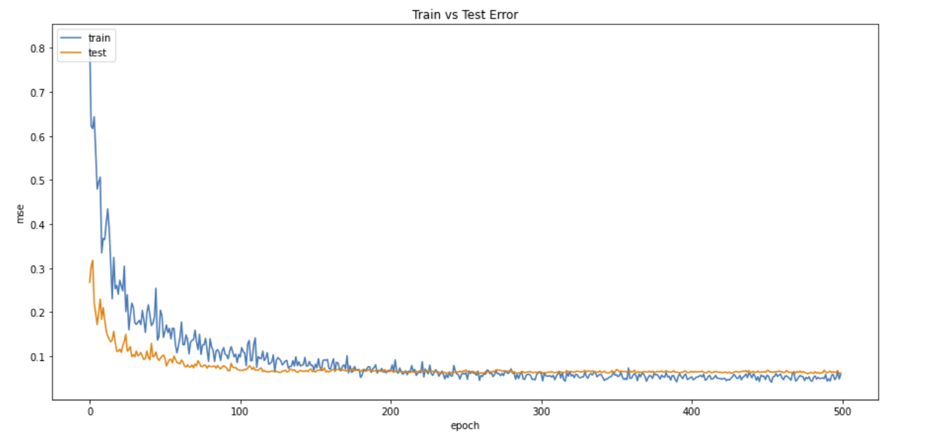
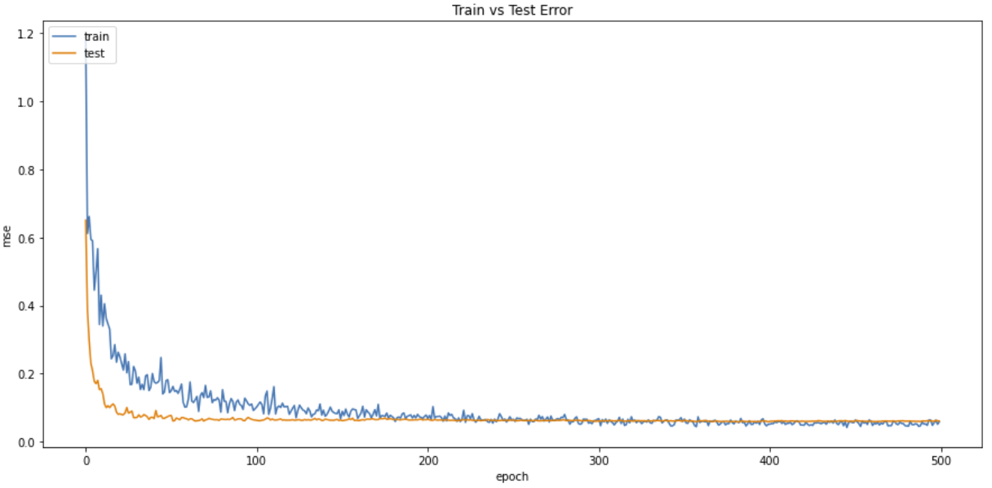
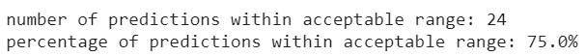
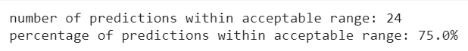
RESULTS
Initial Dataset
Reduced Dataset

Slide 19
04
PROBLEM THREE
Final Driver Standing for Driver driving a particular Constructor

Slide 20
PROBLEM 3
DRIVER’S PERFORMANCE
REGRESSION
Will driver perform better in another Constructor?
Predict the final driver standing position with another constructor

Slide 21
INTEGRATION, CLEANING & TRANSFORMING
INTEGRATION:
Used the data frame created in Problem 1
CLEANING:
Drop redundant attributes
SPLITTING:
Generate Train and Test set
TRANSFORMATION:
Group by ‘driverId’, ‘constructorId’, ‘year’ and aggregate values using mean
Normalize data by changing values of numeric columns to common scale

Slide 22
IMPLEMENTATION
4-LAYERED NEURAL NETWORK:
Performs regression
Adam Optimizer
Learning Rate: 0.001
Learning Decay: 1e-6
1000 Epochs

Slide 23
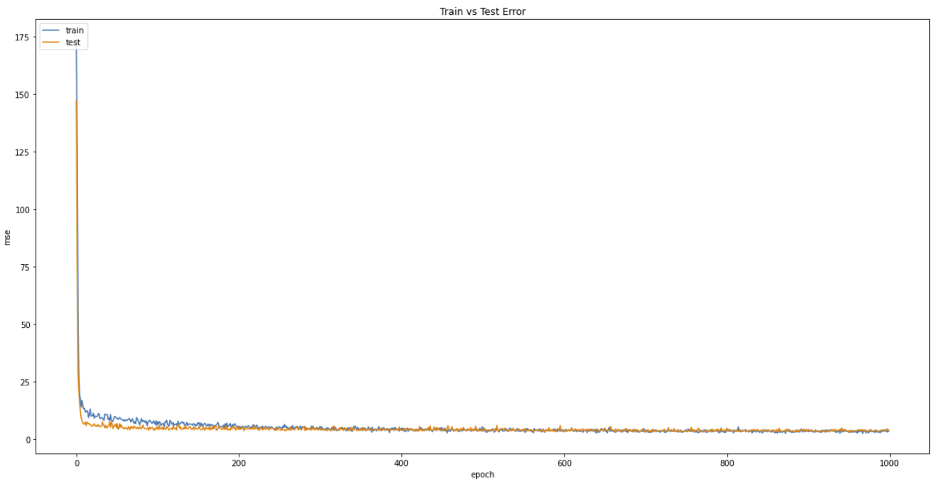
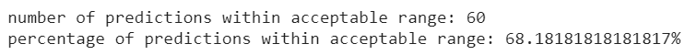
RESULTS

Slide 24
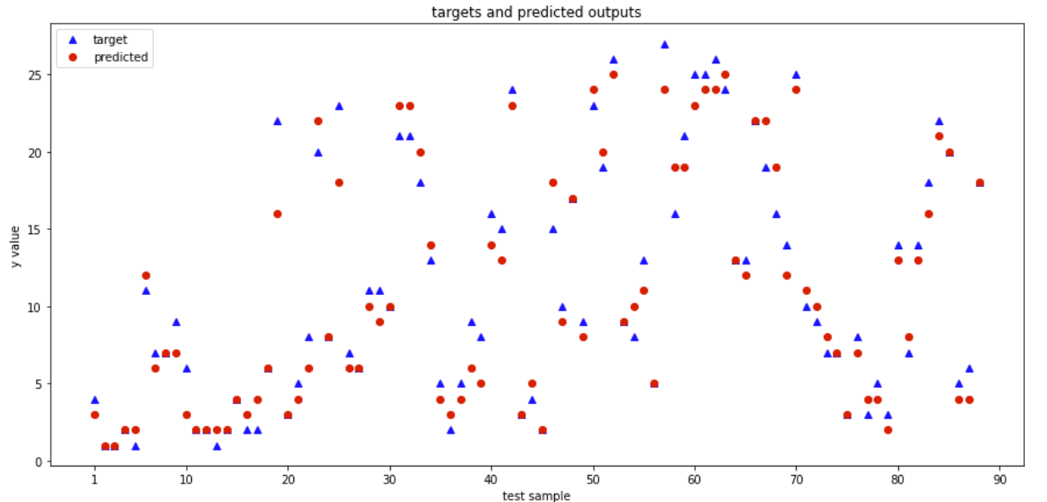
RESULTS

Slide 25
05
Extension of Problem 1
Gather insights on test accuracy of Problem 1

Slide 26
Extension of Problem 1
01
02
03
04
INCREASE CLASSES TO PREDICT
NEW DATASET
Addition of another set of data from Kaggle
2 Classes to 4 Classes Classification
PURPOSE
Labels
Determine if new Classification Model can help derive better insights to race predictions
0 : DNF (Did Not Finish)
1 : Podium (1st to 3rd)
2: PWP (4th to 10th)
3: Finished ( Above 10th position)

Slide 27
IMPLEMENTATION
4-LAYERED NEURAL NETWORK:
Performs Multilabel Classification
SGD Optimizer
Learning Rate: 0.001
Learning Decay: 1e-6
1000 Epochs
80% original dataset
20% used for validation for each epoch
REDUCED DATASET:
sklearn function - SelectKBest
K = 10, 10 input features used for classification

Slide 28
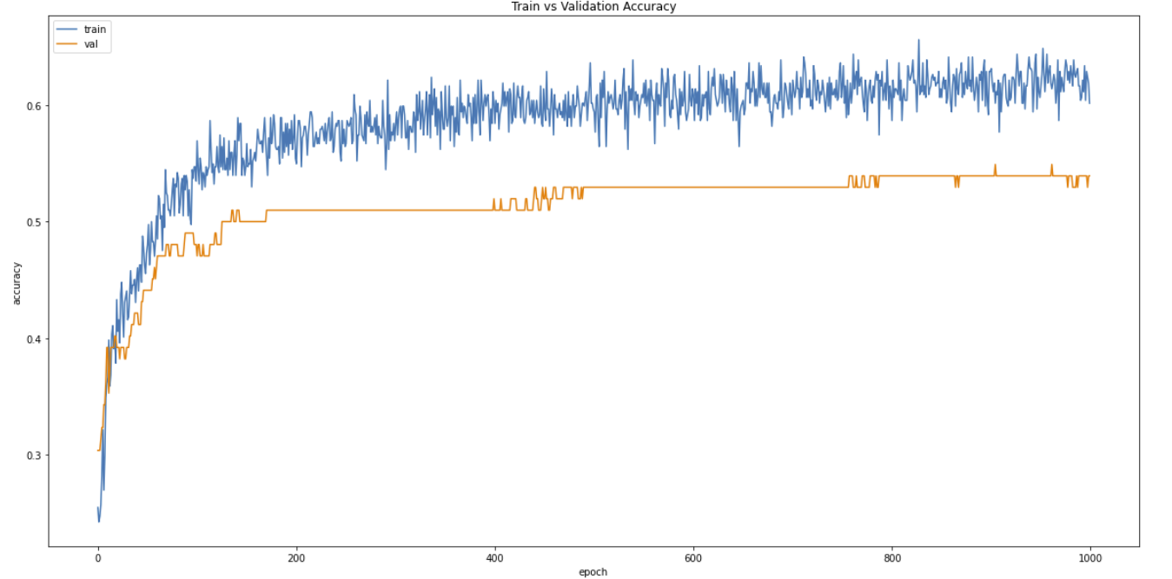
RESULTS
Accuracy vs. Epochs

Slide 29
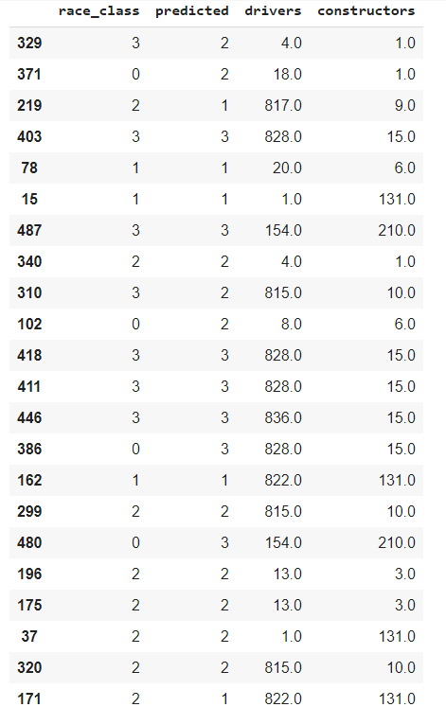
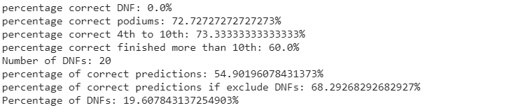
RESULTS
Find out reason for low accuracy
Determine the percentage of correct predictions for each class
0% accuracy for DNF, DNF takes up 19% of test set
Able to achieve decent accuracies for other 3 classes
Hard to predict DNFs as it is hard to determine occurrence of accidents and technical failures

Slide 30
06
CONCLUSION

Slide 31
CONCLUSION
Circuit Informations are not important features
Constructor & Driver informations are more important
Result are unpredictable due to variables such as collisions and accident
Able to achieve decent accuracy for most of the problem.

